Slide 1
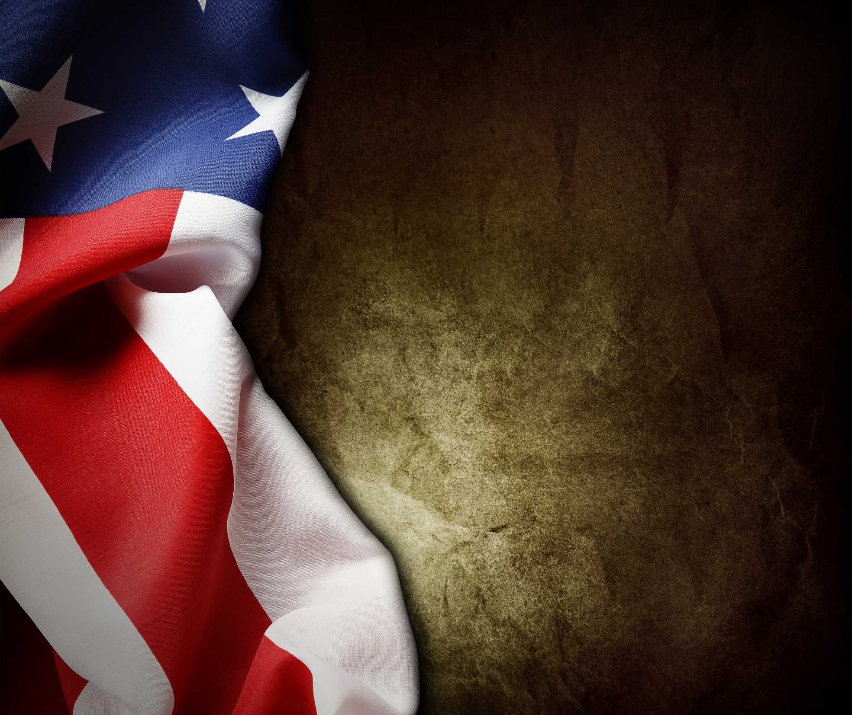
CIVILIAN RESPONSE COURSE
Active Attack Events,
Stress Response, and A.D.D. / Run, Hide, Fight
Notes:
Participants will learn about the shooters, disaster response and how to prepare for and respond to being trapped inside a building during an active shooter event. They will learn steps to take to assist law enforcement and to limit casualties.

Slide 2
Active Attack Events
Notes:
Let’s take a look at some of the research into active shooter events.

Slide 3
Active Attack Event
Definition
=
Attempted Mass Murder
Notes:
The Federal definition of an active shooter event is “one or more people actively engaged in killing or attempting to kill people in a confined and populated area” and then there are a bunch of caveats like – not gang related, not the by-product of another crime . . .
Click for transition –
It is useful to just think of them as attempted mass murders with a firearm. Notice there is no requirement that a certain number of people be shot or killed. Many of the events in the data that we will have few people shot. Some have no one shot.
The data we are going to discuss comes from the 2014 FBI report titled a study of active shooter incidents from 2000 to 2013. The data in this presentation has been updated to include 2014 events.

Slide 4
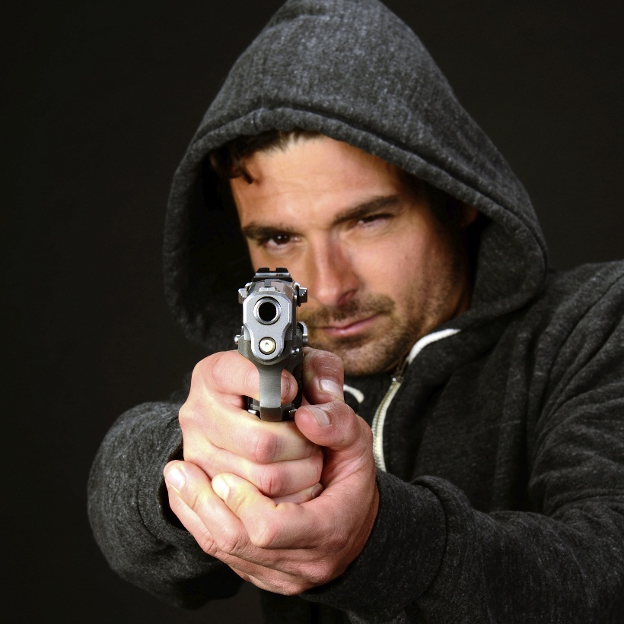
The Attacker
No “Profile”
Avenger mindset
Some broadcast
Notes:
No Set Profile:
Range in age from young to senior citizens.
Most are male, but some have been female.
Come from all races.
Mindset:
Deliberate
Focused
Detached
Bully
Many kill themselves when confronted by the police.
Broadcast:
Some announce their intentions by posting on social media, talking to friends, or other methods.

Slide 5
Risk Factors
History of violence
Exposure to violence
Substance abuse/dependence
Mental illness
History of suicidality
Notes:
Reference: FBI- MAKING PREVENTION A REALITY : IDENTIFYING, ASSESSING AND MANAGING THE THREAT OF TARGETED ATTACKS
The previous slide discusses some commonalities in the shooter(s). Referring to the above slide we believe Awareness and Prevention is key to the successful intervention of an individual before they become and active shooter.
Certain risk factors exist in individuals that may have a propensity for violence. The above listed risk factors are of concern when evaluating a potential threat. Does the person have any of these risk factors? If so, what else is going on in that person’s life? Seek assistance from behavioral experts in the field if needed.

Slide 6
Risk Factors
Stalking, harassing or threatening behavior
Negative family dynamics and support system
Isolation or instability
Others are concerned

Slide 8
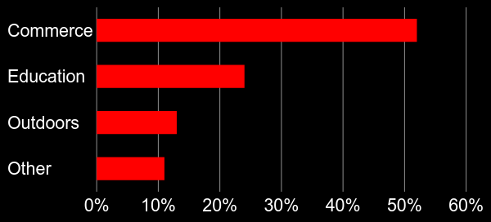
Location of Attacks
Notes:
Many believe schools are the most frequently attacked locations. When combined, businesses and other commerce locations actually make up the majority of attack locations. 2000-2015 for a total 54%

Slide 9
Attacker Connection
Connection
No Connection
Notes:
A shooter is connected if there is a direct relationship between the shooter and the attack site e.g. Employee/former employee or student/former student. A little more than half are connected.

Slide 10
Those who cannot remember the past are condemned to repeat it. - George Santayana
Notes:
Let’s take a look at some of the research into active shooter events.

Slide 11
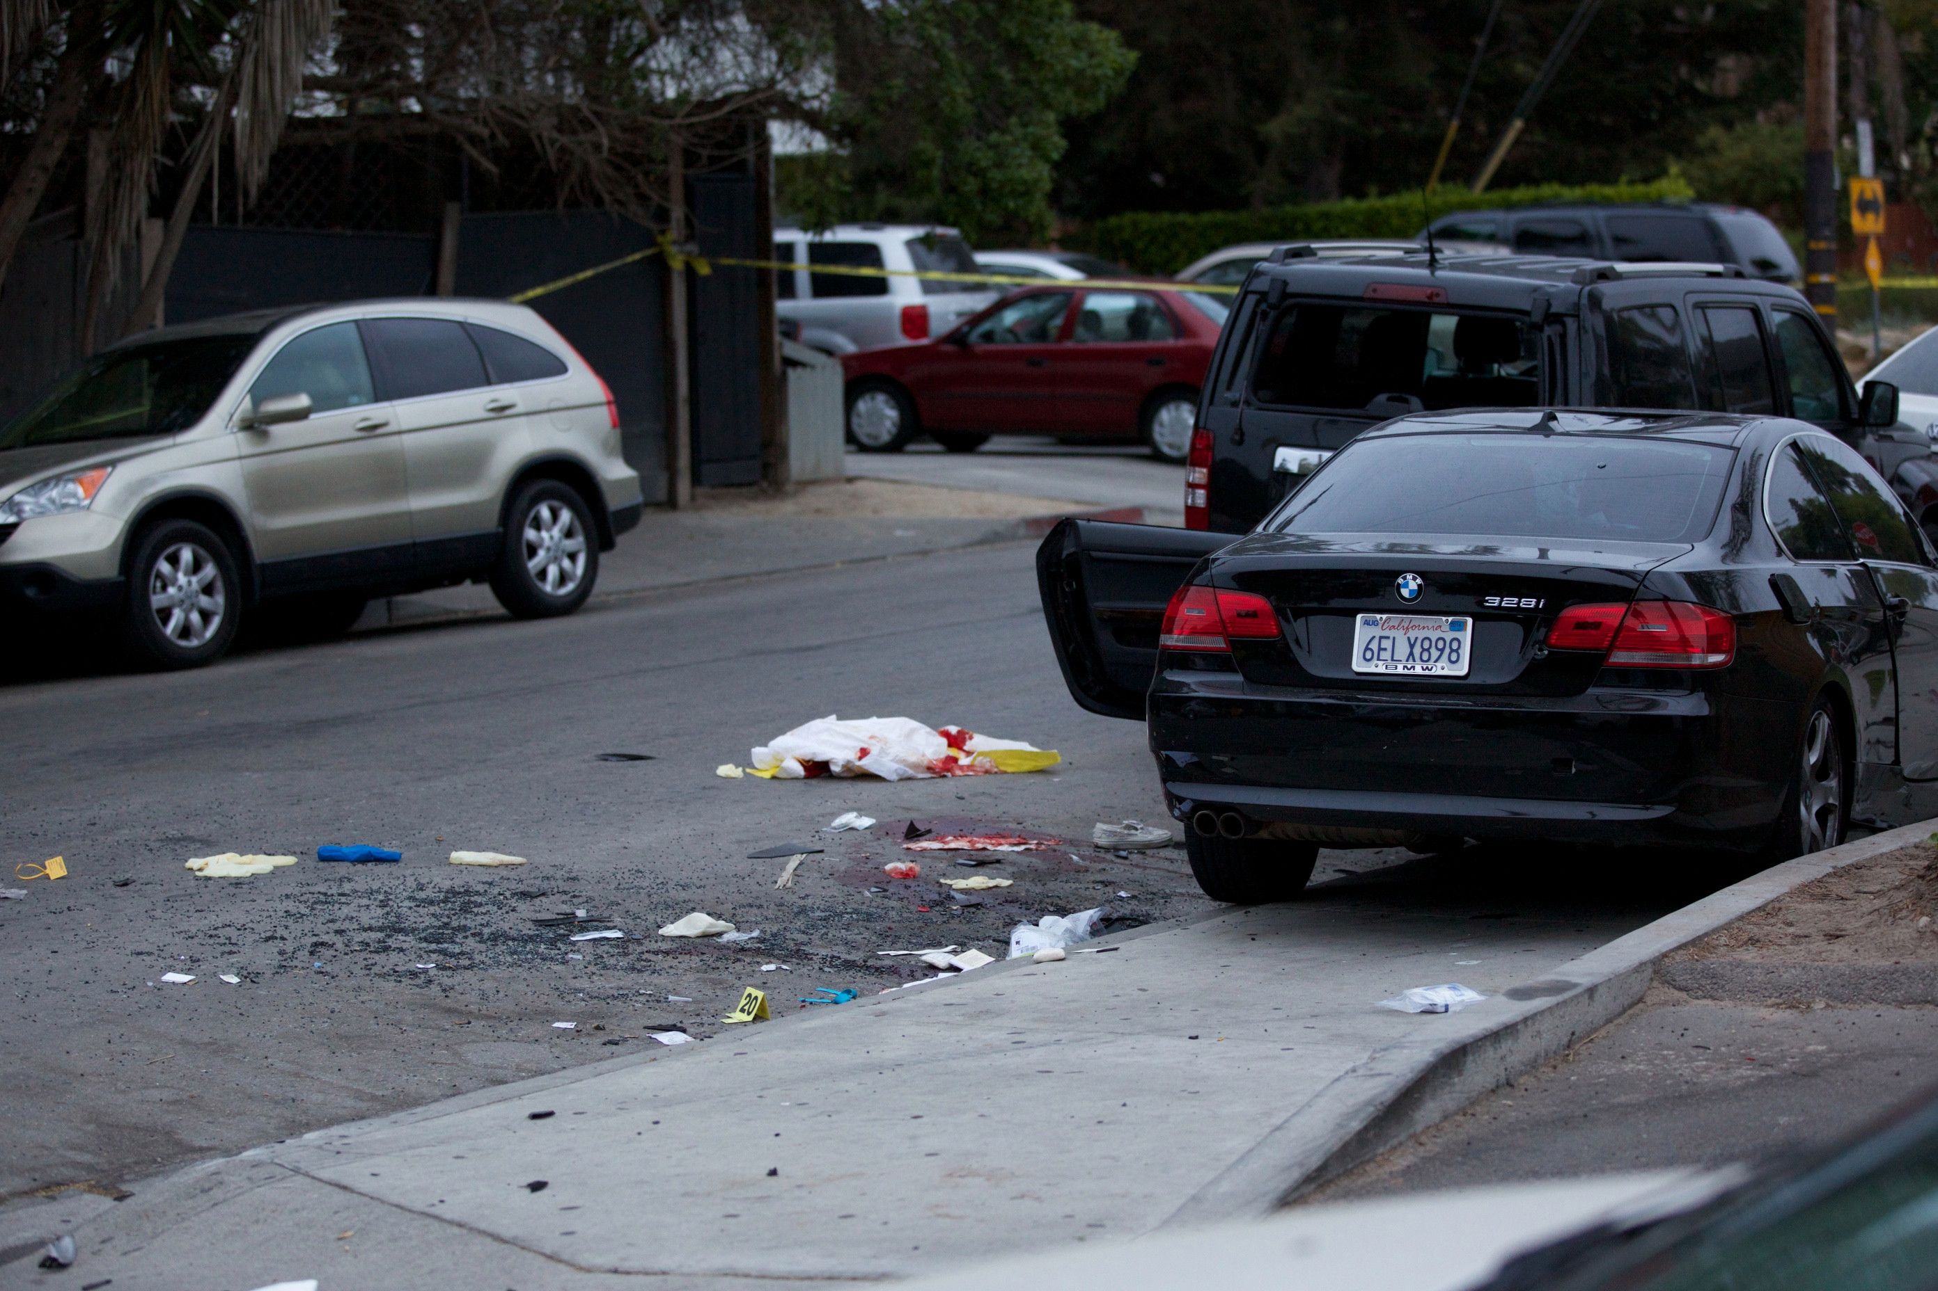
U.C. SANTA BARBARA, CA (2014)
Notes:
Example of “Pure Evil” at its best. The perpetrator killed three people independently by stabbing them at his residence then eventually proceeded to attacking people with a gun on campus and driving a car over others in the street.
This is a prime example of why we have changed from calling these active shooter events to Active Attacker events, this was a multi-pronged, multi-weapons attack, this is an emerging trend.

Slide 12
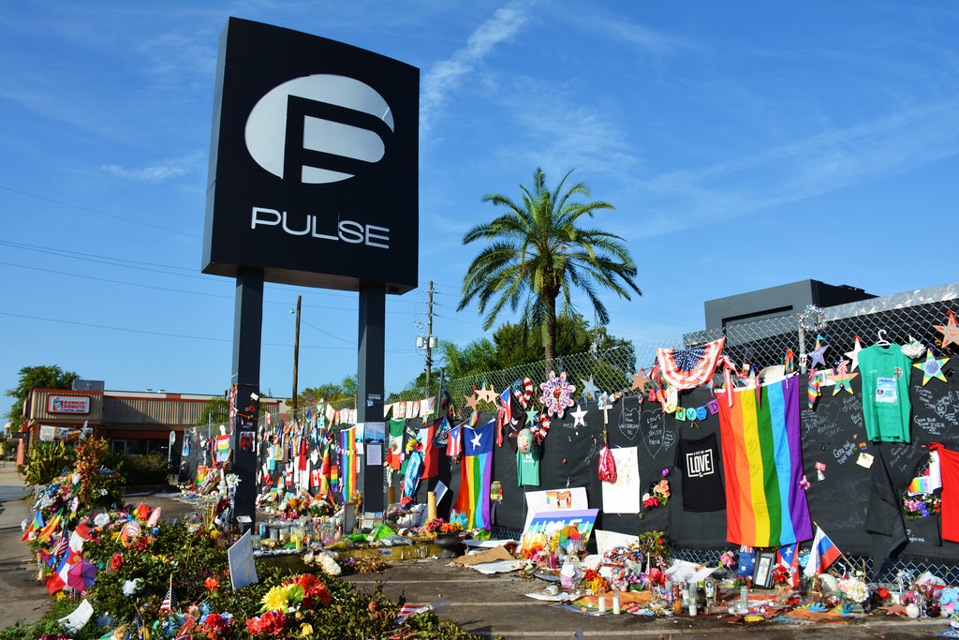
ORLANDO, FL (2016)
Notes:
Pulse nightclub attack where and Islamic inspired terrorist attacked and killed 49 people. The shooter was connected to this nightclub in that he frequented the business as a patron.

Slide 13
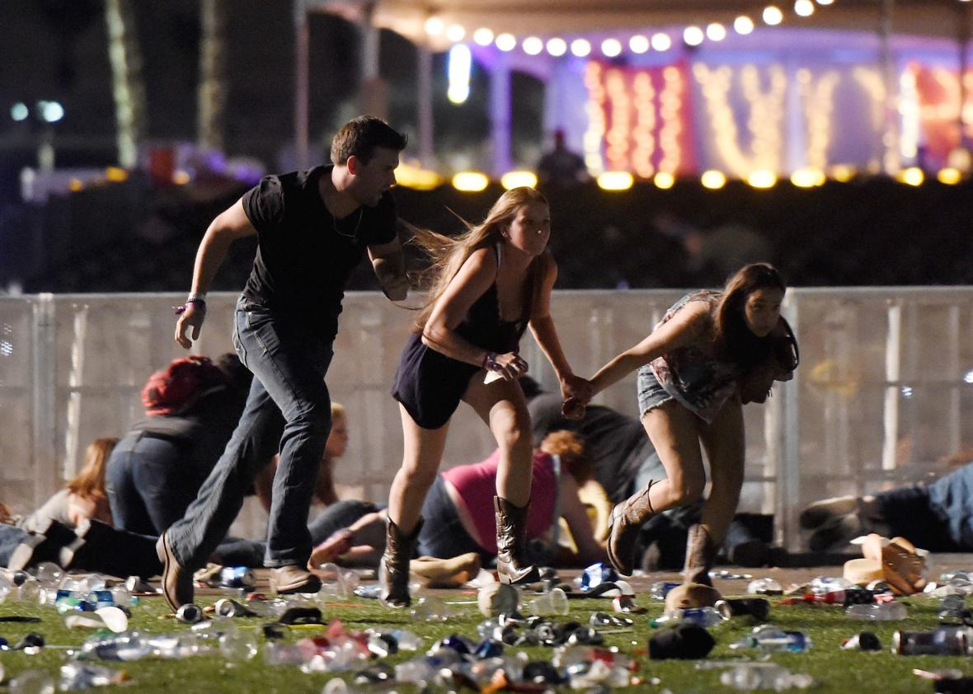
LAS VEGAS, NV (2017)
Notes:
Individual attacked concert goers from an elevated position at the Mandalay Bay Hotel killing 59 making this the highest Active Shooter mass casualty incident since 9-11 in the United States. Stress the use of Avoid, Deny & Defend. Since they were in an open air environment can they deny bullets from hitting them by seeking hard cover. Explain hard cover to people you are lecturing.

Slide 14
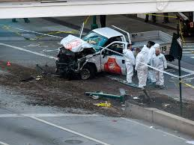
NEW YORK CITY, NY (2017)
Notes:
1 Loan truckman killed 8 and wounded 15 using a Home Depot rental truck.

Slide 15
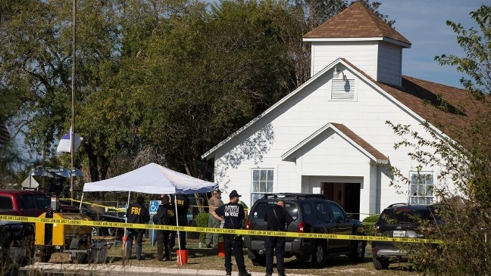
SUTHERLAND SPRINGS, TX (2017)
Notes:
1 Loan gunman killed 26 and wounded 20 more. This person was a Dishonorably discharged Air Force veteran. The shooting began exterior of the church shooting into it and the attacker then moved into the church. Luckily for some of the survivor's a witness retrieved their own weapon and began taking the fight to the suspect forcing him to flee.

Slide 16
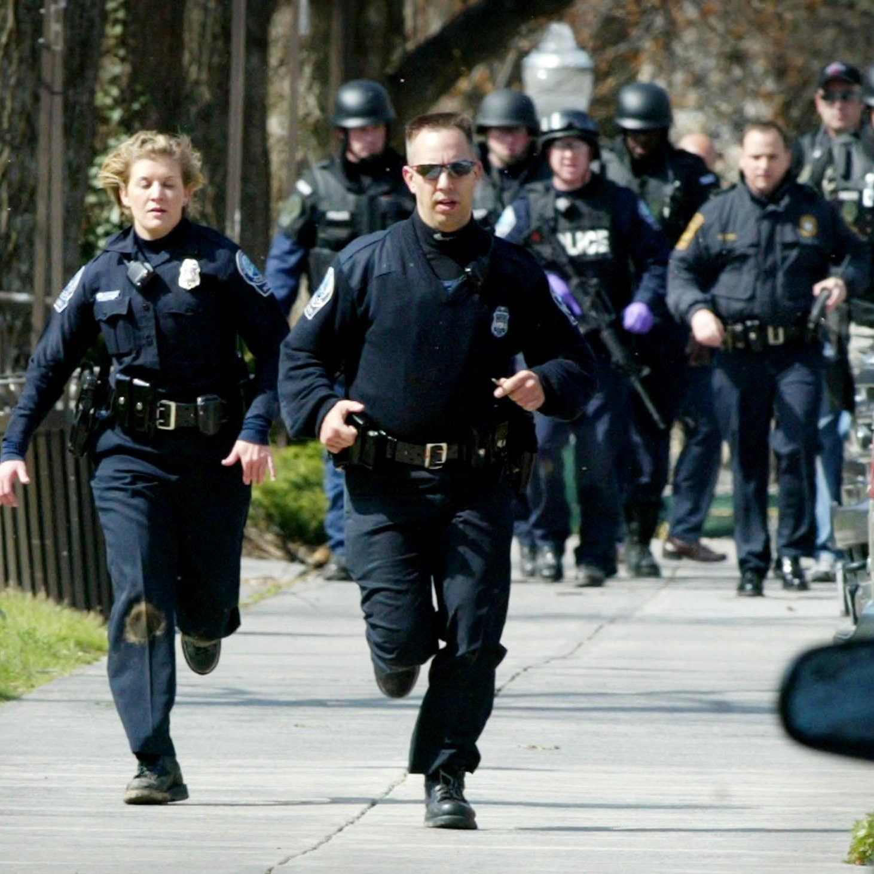
Number of Deaths
How quickly the police arrive
Target availability
Notes:
Image credit: http://www.featurepics.com/online/School-Hallway-Pics140440.aspx
The number of deaths is a product of two things:
Target availability
How long it takes the police to arrive
We train police to get to the site quickly. We are training you to make targets less available.

Slide 17
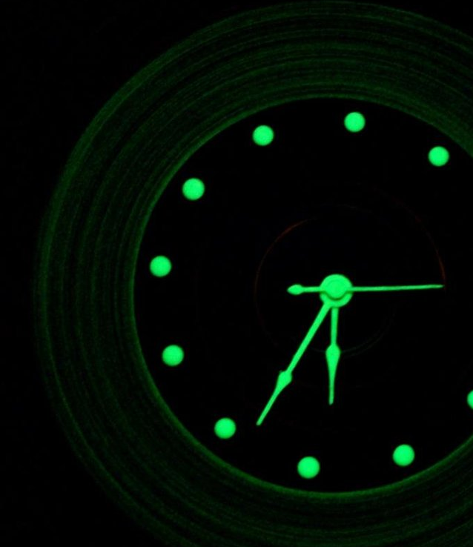
3 Minutes
Notes:
This is a statistic, that can vary greatly depending on location.
Make civilians understand that although 3 minutes is a great response time statistically but that number can vary based upon a number of things such as traffic, other attacks, not being able to get into a location etc. If the incident start time is X and LE response time is Y people need to own everything in between that time. Basically if you give people the false sense of security of 3 minutes they will only train for 3 minutes and nothing longer.
Average law enforcement response time to these events is 3 minutes.
In the law enforcement world, this is considered fast. Improvements can be made by conducting better training with dispatchers, getting them to “hit the button” faster and get officers rolling while still obtaining information.

Slide 18
Disaster Response
The background science of how people behave in high stress events
Notes:
Explain that before discussing too much detail about how people respond during an active shooter event, the class will look at the bigger picture of how people react in disasters and high stress events in general.

Slide 19
Three Stages of Disaster Response
Denial
Deliberation
Decisive Moment
Notes:
Ripley, Amanda. (2008). The Unthinkable: Who Survives When Disaster Strikes And Why. New York: Three Rivers Press.
Ripley did research examining who survives and who dies during disasters. She identified a three-phase process that everyone goes through during these events. People who survive go through the process faster and take better actions at the decisive moment because they have prepared beforehand.

Slide 20
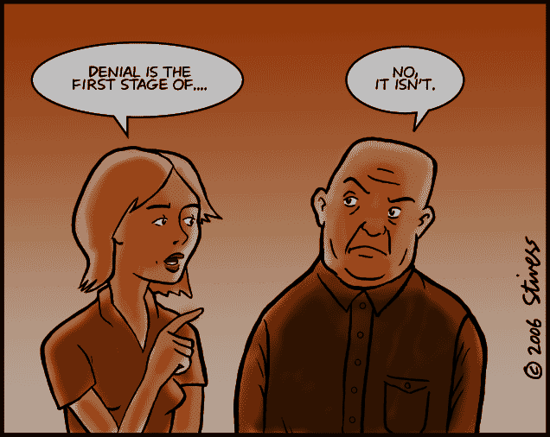
Denial
Notes:
Image credit: http://www.markstivers.com/wordpress/?p=300
Many people do not admit that there is a disaster, or they underestimate the severity of the disaster. People delay taking action and this delay costs lives.
In the World Trade Center, people called others to check with them, logged off of their computers, and packed up their things before beginning to evacuate.
So why do people do it?
Normalcy Bias – The brain is lazy. It wants things to fit into existing plans. It tries to define a disaster as something else that we are already familiar with. For example, in active shooter attacks, many people describe hearing the shots, but attribute it to fireworks. This is because the brain is more easily able to process someone shooting off fireworks than someone shooting or murdering people.
Social Proof – We are social animals. We look to each other for clues about how to behave. This is especially the case when a situation is new or ambiguous. Consider any time you might have been at a large, formal dinner party. There are many different plates, glasses, and silverware for each person. If you are unsure about which utensil to use, a very easy way to determine the appropriate response is to watch others around you to see what they are using … and then do the same. This is important because a few people doing the right things can save many.

Slide 21
Social Proof
Notes:
Social Proof (also linked to diffusion of responsibility)
In novel or ambiguous situations we look to others for information on how to act
If others are doing nothing, you will tend to do nothing
If others are acting, you will tend to act
Also note that this is the transition to deliberation – Many deny, but some see it and start to realize the problem, but don’t know what to do.

Slide 22
Deliberation
Notes:
Image credit: http://www.thisbloglife.com/2012/06/signage-design-is-a-creative-challenge/
The next phase Ripley identified is that once people get past Denial, they enter the Deliberation phase. They understand something bad is happening, and now they must decide what to do.
This is a problem because their brain is not functioning well because of the effect stress has on the body. Additionally, this is where fear enters the equation because people now know this is a potential life-and-death situation.

Slide 23
Deliberation
Human Brain
Lizard Brain
Notes:
Click to bring up Human Brain – it is
Reflective
Thinking brain
Flexible
Rational
Slow
You have to think about it
Click again - Lizard Brain
Reflexive
Reacting Brain
Fixed
Emotional
Fast
It just happens

Slide 24
Deliberation
Human Brain
Lizard Brain
Fight
Flight
Freeze
Notes:
Click to bring up Human Brain – it is
Reflective
Thinking brain
Flexible
Rational
Slow
You have to think about it
Click again - Lizard Brain
Reflexive
Reacting Brain
Fixed
Emotional
Fast
It just happens

Slide 25
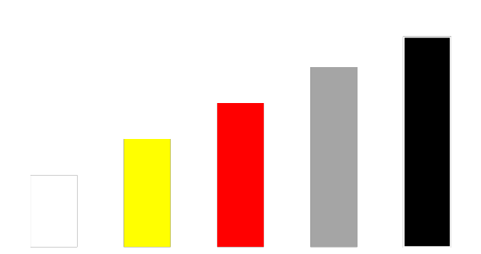
Stress Response
175 BPM
150 BPM
120 BPM
90 BPM
Heart Rate
60 BPM
Notes:
Image credit: http://emcrit.org/podcasts/emcrit-book-club-on-combat-by-grossman/
Walk thru a specific example where an incident ranges from “quick startle” through an increased stress response. An example is a “home alone” scenario, where you hear a noise, then hear it again and sounds like right something outside, then you hear someone sliding the screen, then hear glass breaking on door, then someone coming in house.
Condition White – Normal resting heart rate
Condition Yellow – Fine motor skills deteriorate
Condition Red – Complex motor skills deteriorate, but peak physical performance in gross motor. You are stronger, faster, and will bleed less.
Condition Gray – Cognitive processing deteriorates, tunnel vision, auditory exclusion, time dilation
Condition Black – System overload, freezing, voiding of bowels and bladder

Slide 26
Stress Response
Notes:
Instructor notes: Notice the length of time it takes the female with the stroller to remove the child from it. She never properly removes the child; however, she does achieve the goal through brut force eventually. Note that it takes her 10 seconds to remove the child, a task that she does dozens of times daily. However, under stress she is incapable of performing this task in a timely manner. In these incidents 10 seconds can be a lifetime with a focused aggressive attacker no matter the weapons system in use. Panicked people are bouncing into each other, knocking others over. Some are seeking to “hide” in plain sight.

Slide 27
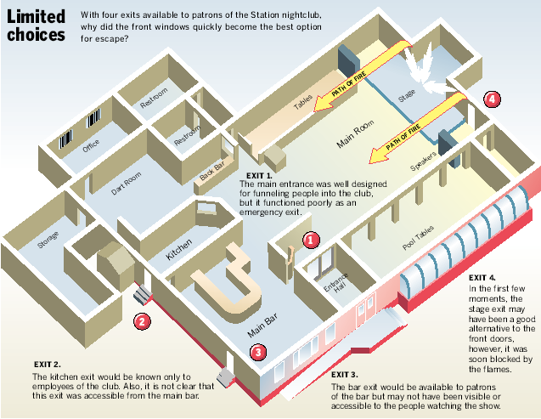
Deliberation
Notes:
Image 1: https://en.wikipedia.org/wiki/The_Station_nightclub_fire
This is the floor plan of the Station Nightclub. Notice the 4 exits marked in red numbered circles.

Slide 28
Station Night Club
Notes:
Remind the audience that what they are about to see and hear may be disturbing to some. As tragic as it is to view, this video vividly illustrates the problem of human performance and decision-making under extreme stress. The video shows Social Proofing in action. Initial denial even when it is obvious that the flames have reached the roof. This then sparks a stress response from people that only know one way out.

Slide 29
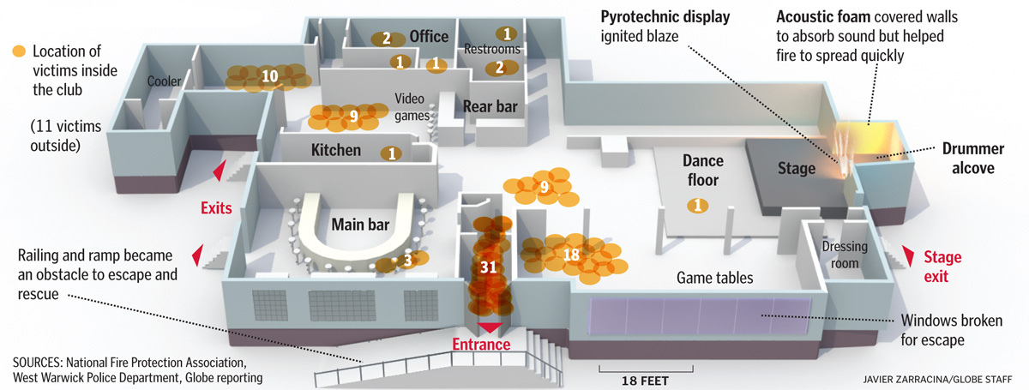
Deliberation
Notes:
https://www.google.com/search?q=station+night+club&tbm=isch&tbo=u&source=univ&sa=X&ved=0ahUKEwjjn9PM8erWAhUpl1QKHduBCx8QiR4IgQE&biw=1600&bih=794#imgrc=o0W15B-IAlAKeM:
Each yellow circle represents a bodies found at that location, with a total number bodies in white for that area. The number of dead in the exit hall is 31.
Initially there was no panic and people were still able to use their Human brain to process a proper response—to get out. Once the primary entrance was clogged and inaccessible, panic set in and people reverted to their Lizard brain. The only thing they were thinking was to get out. When they were able to think rationally, they knew there would be more than one exit, besides the one they used to enter the building earlier. However, under stress and relying solely on the Lizard brain, all they could think of was to flee to the door through which they had entered the building. When the Human brain shuts down, the Lizard brain takes over but provides very few options if not properly prepared ahead of time.

Slide 30
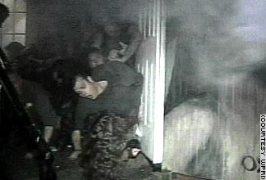
Deliberation
The numbers with circles around them are the number of bodies found at each location. The number of dead (that’s difficult to read) in the exit hall is 31.
Initially there was no panic and people were still able to use their Human brain to process a proper response—to get out. Once the primary entrance was clogged and inaccessible, panic set in and people reverted to their Lizard brain. The only thing they were thinking was to get out. When they were able to think rationally, they knew there would be more than one exit, besides the one they used to enter the building earlier. However, under stress and relying solely on the Lizard brain, all they could think of was to flee to the door through which they had entered the building. When the Human brain shuts down, the Lizard brain takes over but provides very few options if not properly prepared ahead of time.
The numbers with circles around them are the number of bodies found at each location. The number of dead (that’s difficult to read) in the exit hall is 31.
Initially there was no panic and people were still able to use their Human brain to process a proper response—to get out. Once the primary entrance was clogged and inaccessible, panic set in and people reverted to their Lizard brain. The only thing they were thinking was to get out. When they were able to think rationally, they knew there would be more than one exit, besides the one they used to enter the building earlier. However, under stress and relying solely on the Lizard brain, all they could think of was to flee to the door through which they had entered the building. When the Human brain shuts down, the Lizard brain takes over but provides very few options if not properly prepared ahead of time.
Notes:
https://www.google.com/url?sa=i&rct=j&q=&esrc=s&source=images&cd=&cad=rja&uact=8&ved=0ahUKEwiarKmN9erWAhWCjVQKHbENDR4QjRwIBw&url=https%3A%2F%2Fwww.reddit.com%2Fr%2Fwatchpeopledie%2Fcomments%2F6ubdni%2Fthe_station_nightclub_fire_which_occured_on%2F&psig=AOvVaw1FmcZ32JTYb6cDUtBcEmJN&ust=1507891767779653
M- Here is best photo I can find.

Slide 31
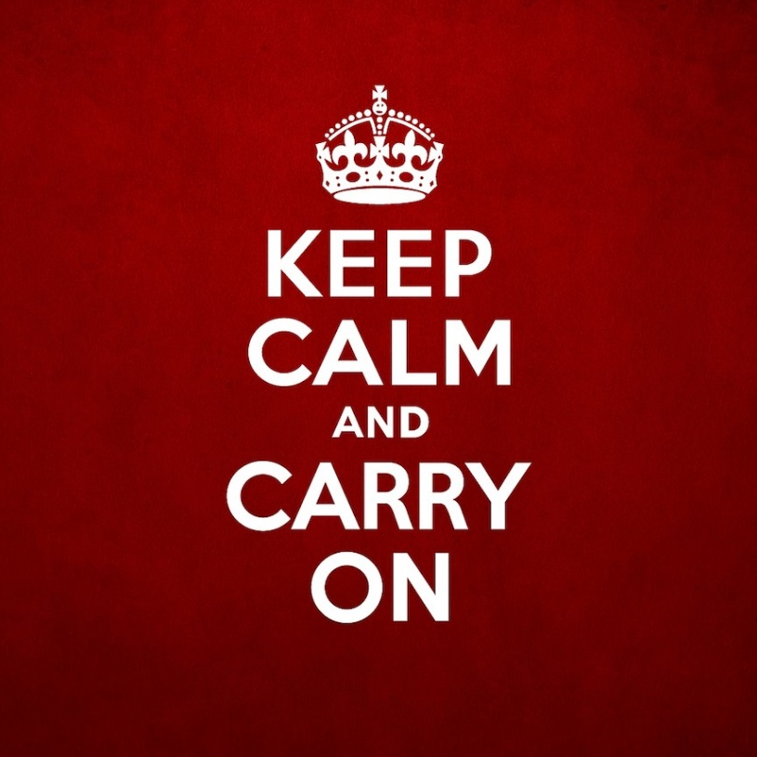
Deliberation
Calm yourself
Breathe
Shift your emotion
Stay fit
Notes:
You obviously want to keep your Human brain running as long as you can. These techniques can help you do it.
1. Tell yourself to calm down.
2. Breath in slowly through your nose, hold it at the top for 2 seconds, breath out slowly through your mouth, and hold it at the bottom for 2 seconds. This can slow your heart rate by 20-30 beats per minute and put you 1-2 conditions lower on the stress scale.
You are going to be scared, but you can change that to a more useful emotion like anger.
Stay fit. Research has shown people who are fit are generally more able to cope with stress.

Slide 32
Deliberation
Script
Practice
Notes:
No matter what, eventually people get placed under enough stress that their Human brain shuts down.
One of the cool things about your Human brain is that you can use it to program your Lizard brain beforehand, when you are not under stress. Then, your Lizard brain does a better job when you are under stress.
Scripting means thinking through if/then scenarios in your head so that you have a better plan ready. Practicing reinforces this plan.

Slide 33
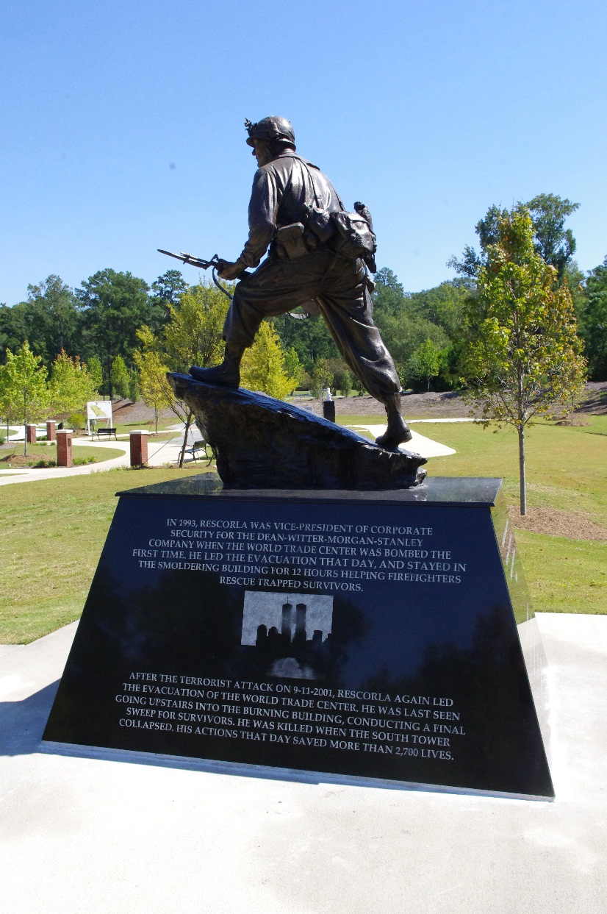
Rick Rescorla
Notes:
Image 1: http://blog.nationalinfantrymuseum.com/2011/09/ap-911-heroes-soothed-and-inspired.html
(Click on the slide to enlarge the inscription. Read the inscription when it enlarges.)
Explain that Rick Rescorla devoted his life to protecting his coworkers. We aren’t asking civilians to go this far, but just take a few minutes and think about what might happen and how you should respond.

Slide 34
Decisive Moment
Notes:
Spencer Stone, Alek Skarlatos and Anthony Sadler story. These three men fought through fear and move to the decisive moment to defend not only themselves, but the others on the train that day. Moving through denial and into action requires commitment to ones self as well as to the others that are depending on you to lead them in a grand social proofing experiment that could mean lives.
AMANDA RIPLEY STATES THAT PEOPLE WHO CYCLE THROUGH THESE STAGES ARE MOST LIKELY TO SURVIVE. THIS IS A PRIME EXAMPLE IMO OF THAT.

Slide 35
Civilian Response
Notes:
Let’s look specifically at the response options we would like civilians to remember and reference them back to Ripley’s three phases of disaster response.

