Slide 1
Severe Weather Preparedness for Vulnerable Populations
Joseph Annelli
Ann Horton

Slide 2
Severe Weather Events
Severe weather carries several risks
  Loss of Power
    Mobility, Perishables, Communication
  Loss of Infrastructure
    Roads, Supplies, Access
Hurricane Sandy
  11 Deaths
  Hundreds evacuated from Crisfield
  Hundreds of seniors unreachable

Slide 3
2012 Derecho: June 29th – July 8th
A fast-moving band of thunderstorms and straight line winds
Caused widespread wind damage and power outages with 1 million customers without power at the peak
  This compares to a estimated Maryland Population of 5.8 Million, meaning more than 1 in 6 Maryland residents lost power
Followed by more than a week of extreme heat throughout most of the State
Heat indices peaked over 105 degrees in some areas
There were 24 reported heat-related deaths during the event
The State Emergency Operations Center (SEOC) was activated for nine days.

Slide 4
Extreme Heat
The month of July is always the hottest of the season
Lack of Air Conditioning is the primary cause of death for vulnerable populations
Maryland 2012: 46 deaths, over 3,400 ED visits*
Maryland 2013: 17 deaths, over 2,700 ED visits*
Maryland 2014: 8 deaths, over 2,900 ED visits*
*ED visits with a chief complaints of hyperthermia,
heat and dehydration
Notes:
*The results from the query used in ESSENCE to track heat-related illnesses may be an overestimation of the actual burden of illness related to the hot weather. This overestimation is due to the nature of the query, which includes the term dehydration, a condition that may be caused by factors other than heat.

Slide 5
Summary of 2012 Heat-related Deaths
46 heat-related deaths in 2012
56% of those found in their residences lived on their own
22% were found dead a week or more after last being seen
  Longest time between last known contact and death was 19 days
7% had signs of drug or alcohol abuse
46% had available air conditioning when discovered*
  6% had air conditioning turned on
  Those with active air conditioning had been working outside
61% occurred during the Derecho
Notes:
* Based on the number of individuals found in their residences

Slide 6
2015 Storm Season
Early outlook shows a below average season for the number of storms
7 named storms, with one major hurricane
Does not mean a less destructive season
  Seasons with a high number of forecasted storms don’t always affect Maryland, either
Always have a Plan
  Make a kit
    Back-up supplies (batteries, medicine, etc)
  Lists of Medications and Emergency Contacts

Slide 7
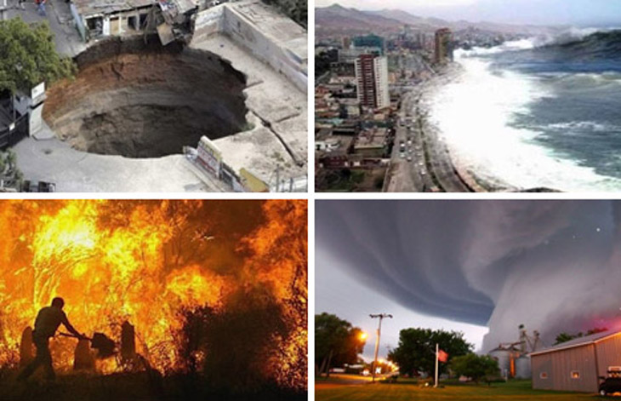
Emergency Management

Slide 8
Emergency Preparedness
In general, we can speak of four levels of preparedness
  Personal/Private
  Local / regional
  State
  Federal
Emergency management can be thought of as a process of “gathering, knowing, and accessing”
  Gathering: resources and relationships
  Knowing: what help is available and where from
  Accessing: help from appropriate agencies in through established means

Slide 9
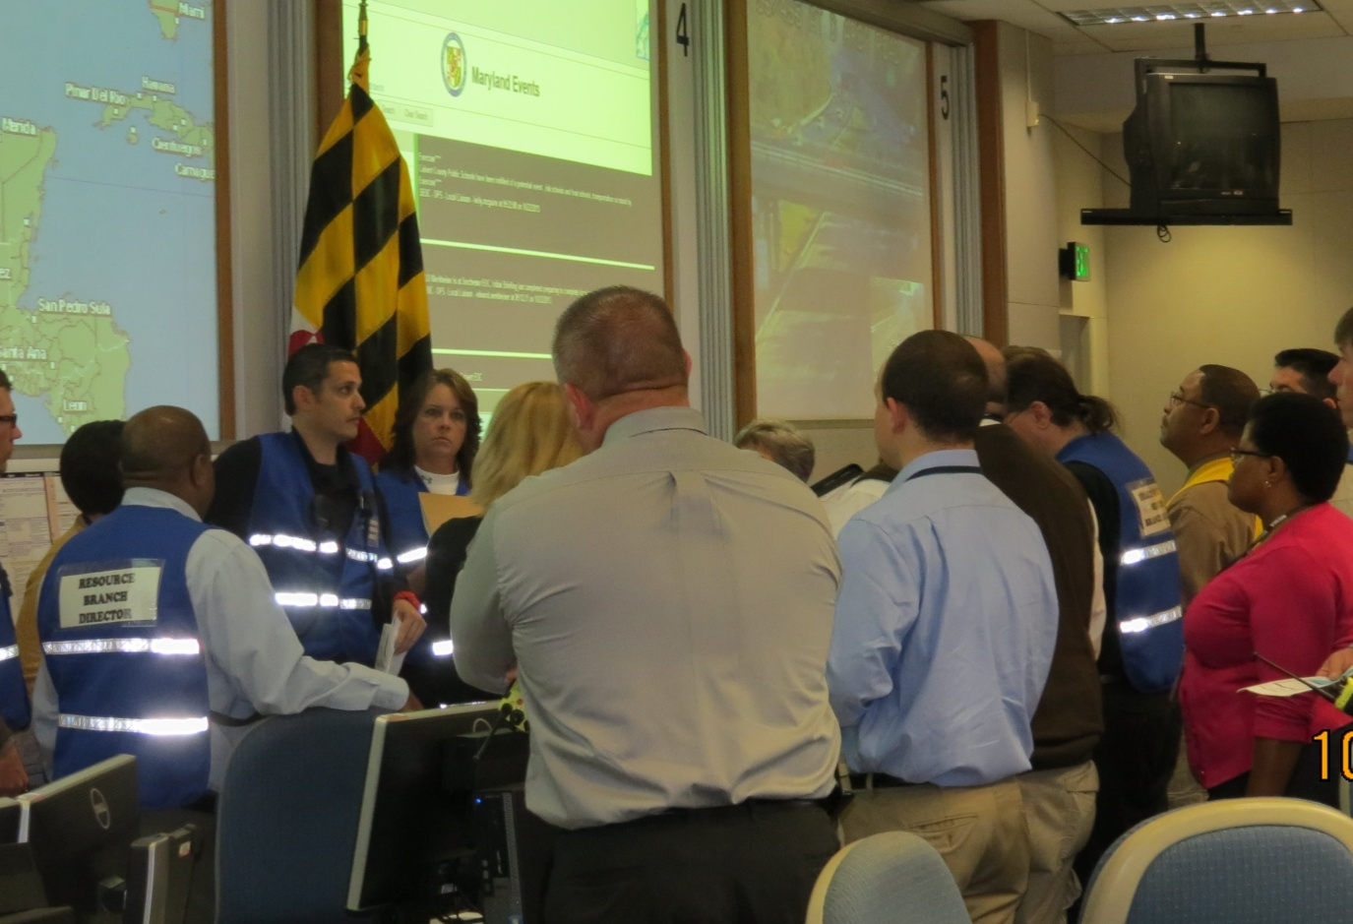
Emergency Management in Maryland

Slide 10
Local Emergency Management
Coordinates the local response
  Brings organizations with into response
  Fulfill resource requests
Emergency Operations Center
  Command center for overall incident
  Houses representatives from many different organizations with different roles

Slide 11
Local Health Department
Provides medical staff for shelters
Provides guidance to medical professionals on public health issues
Tracks licensed facilities during power outages

Slide 12
State
Governor’s Declaration
Emergency Support Functions
Maryland Emergency Management Agency
Maryland Department of Health & Mental Hygiene
Maryland Department of Human Resources
Maryland Department of Disabilities

Slide 13
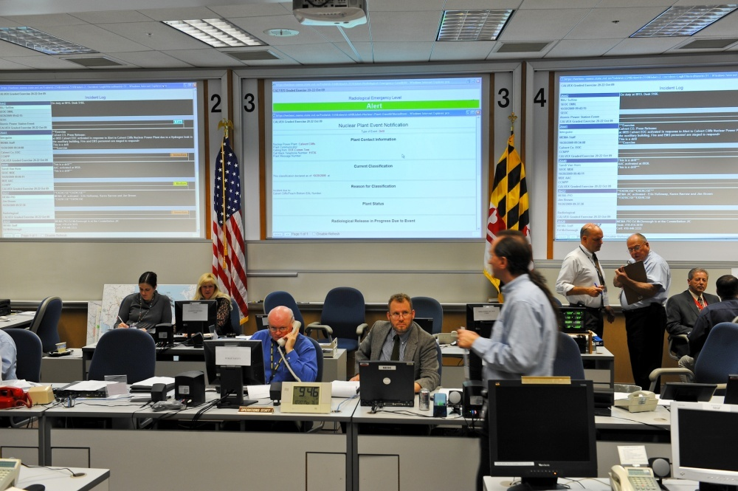
Maryland Emergency Management Agency
Monitor threats through joint operations center
Elevate activation level
Coordinate ESFs
Fulfill resource requests

Slide 14
Maryland Department of Health & Mental Hygiene
Issue guidance to clinicians on public health threats
Track licensed facilities during power outages
Provide medical staff for state-level shelters
Manage professional volunteers
PODs
Insurance Waivers

Slide 15
Federal
Presidential Declaration
Federal Emergency Management Agency
  Support role to State and Locals
  Financial Assistance to individuals
Health & Human Services
  Hospital Preparedness Program
  Public Health Emergency Preparedness
  Strategic National Stockpile

Slide 16
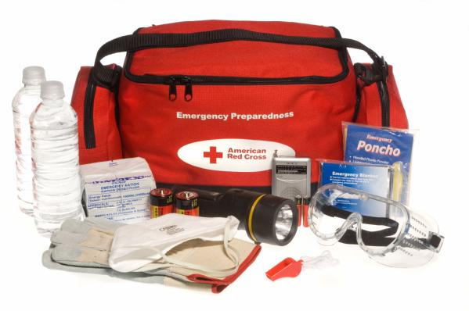
Personal Preparedness

Slide 17
Personal Preparedness
Prepare everything you might need
  Food, water, flashlight, batteries, functional needs specific supplies, etc
  Resources:
    Ready.gov
    MNCHA
    2-1-1 Maryland
Make sure you have a plan
  How will you communicate?
  Where will you meet family members?
  Where are your local shelters?
  What are the evacuation routes?

Slide 18
Personal Preparedness (Cont.)
Engage your community
  Make sure you’re aware of their needs
  Make sure they’re aware of yours, especially if you have functional needs
Preparedness reduces the burden on response
  Focus on those who haven’t or weren’t able to prepare
  Supplies and funding go farther

Slide 19
Private Entities
What should a private entity do to prepare?
Are your employees prepared?
Communicate with/represent/advocate for their constituencies
Important considerations:
  Continuity of Operations
    Maintain critical functions in an emergency
  Recovery
    How to restore normal operations after an emergency

Slide 20
Resources
Ready.gov
MNCHA.org
211md.org (or Dial 2-1-1)
Mema.maryland.gov
Maryland Department of Disabilities
  Main Line: 410-767-3660
  MDOD@mdod.state.md.us

Slide 21
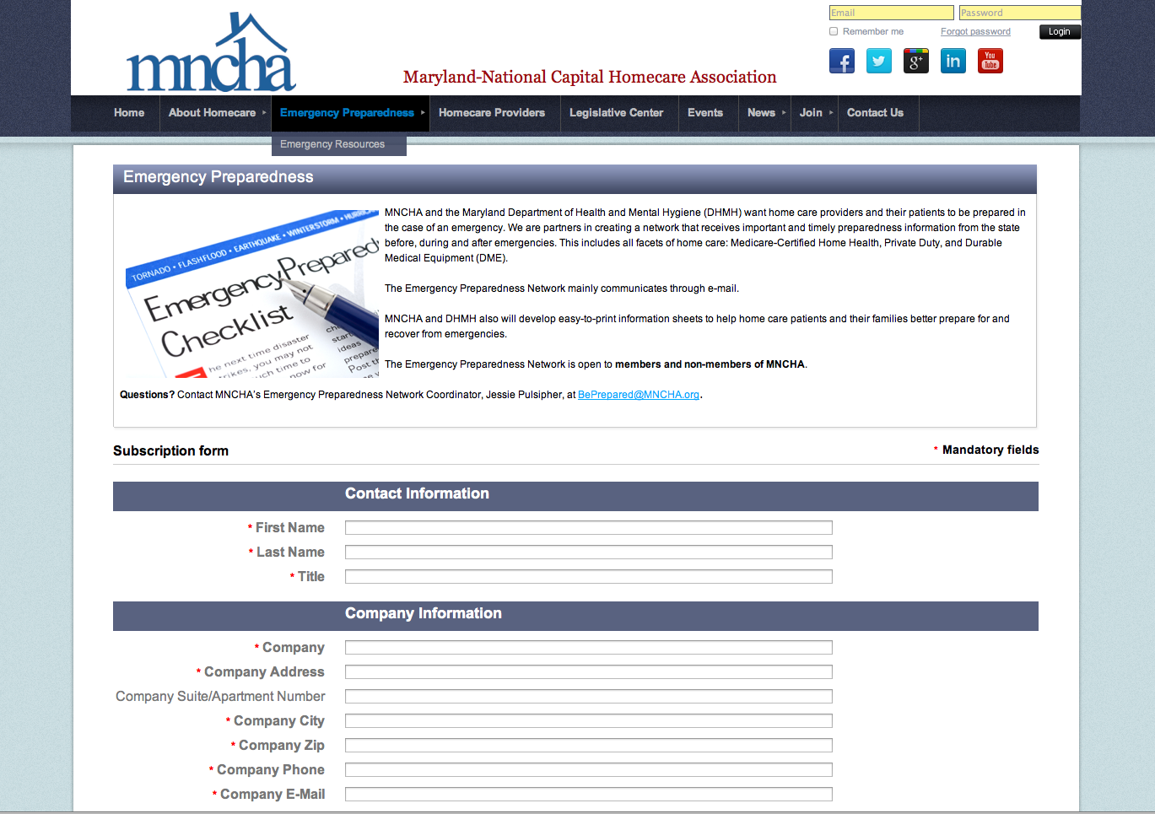
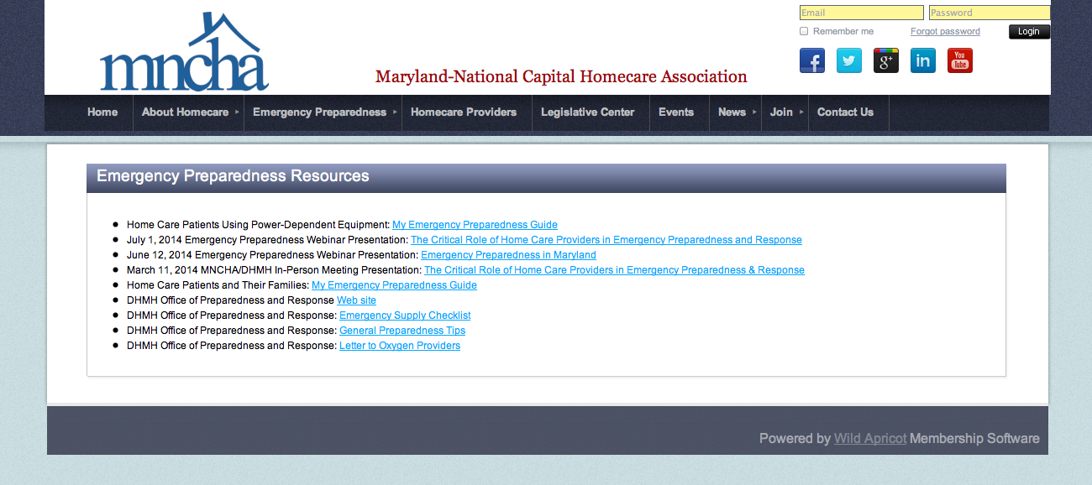
www.mncha.org

Slide 22
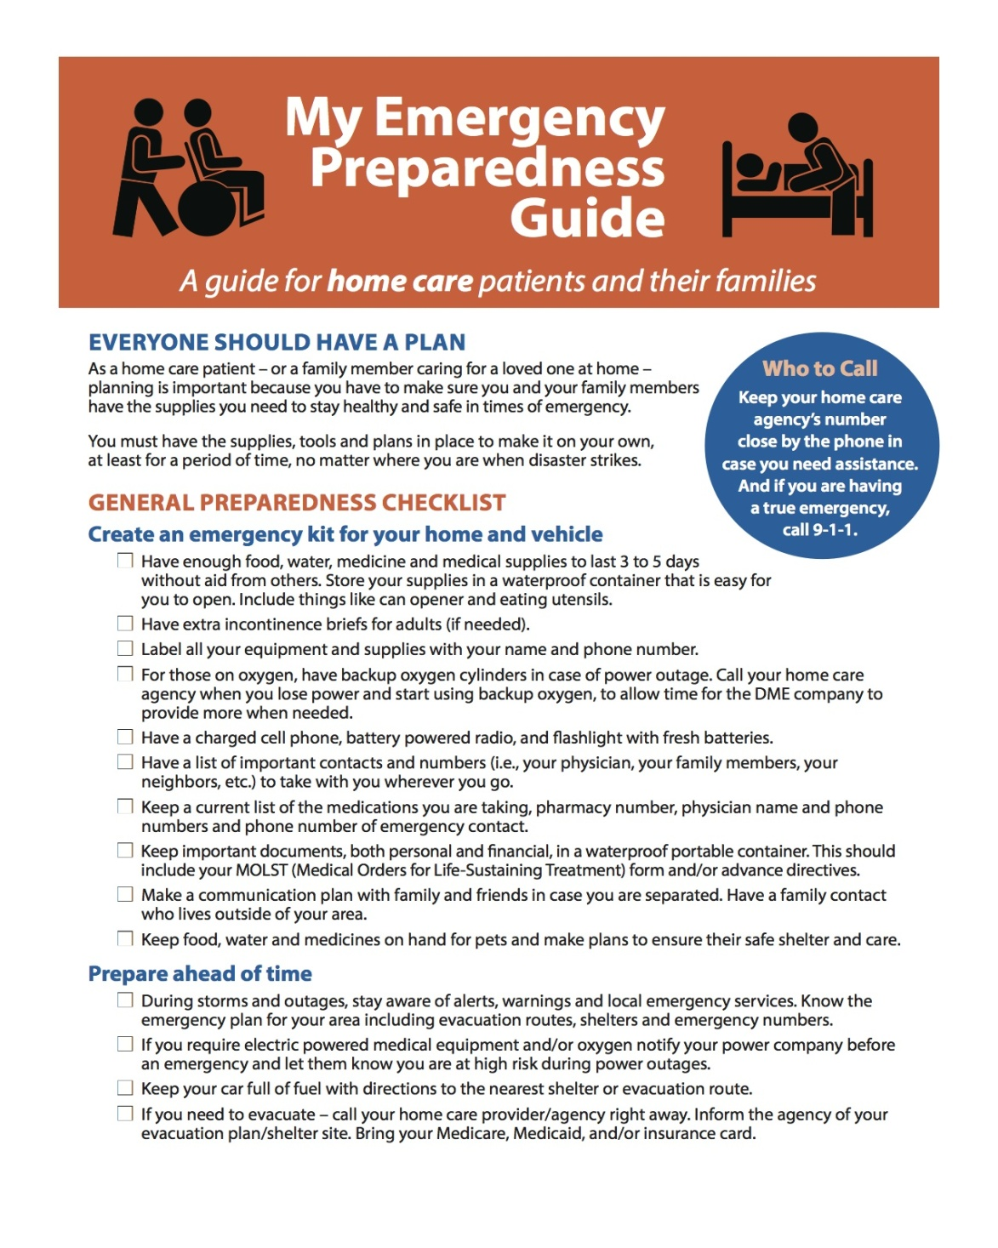

Slide 24
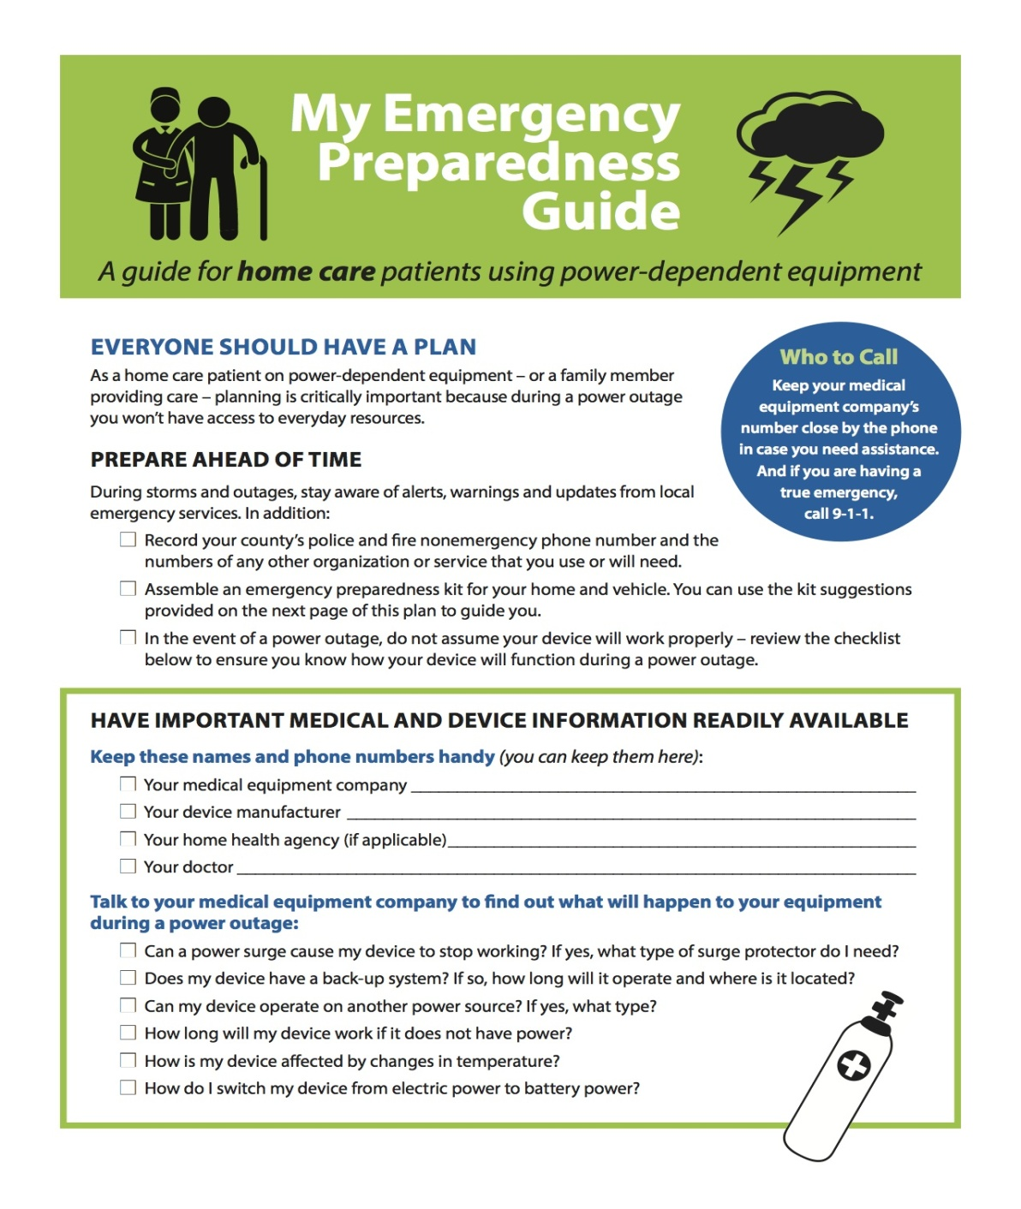

Slide 25
EP Manual for Home Care Providers
MNCHA is producing a free manual for home care providers on emergency preparedness
Step-by-step guide to developing a plan for your company – including templates
Coming June 2015

Slide 26
Emergency Preparedness Training for Home Care
Free conference for home care providers June 16, 2015 from 9:00 a.m. to 4:00 p.m.
Location: Loyola University Maryland – Columbia, MD.
Trainer: Barbara Citerella
Currently 52 registrants
Includes training and tabletop exercise
Info and registration at www.mncha.org

Slide 27
Questions?

